Slide 1

PRO-ACTIVE PDF THREAT DETECTION for SOC & Red Team Defense
Analyst,
Bassey Solomon henry

Slide 2
️ Presentation Note Title: Proactive PDF Threat Detection for SOC & Red Team Defense
Objective: Showcase a defensive lab that automates detection of potentially malicious PDFs before they are opened.
Tools Used:
PDFiD: Signature-based PDF metadata scanner.
ExifTool: Metadata extractor for deep analysis.
inotifywait: File system event monitor to watch Downloads directory.
Real-World Value:
Prevents waterhole, spear phishing, or document-based malware threats.
Builds awareness and automation into user workflows.
Prevents HR, finance, or legal teams from opening suspicious files unknowingly.

Slide 3
🎯 Business Value:
🛡️ Capabilities:
Monitors ~/Downloads in real-time
Scans for malicious PDF indicators:
/JavaScript
/Launch, /OpenAction
/EmbeddedFile
Logs alerts to a file
Sends desktop notifications
Automatically starts at boot via systemd
Prevents HR & Finance teams from falling victim to document-based social engineering.
Adds a zero-cost, high-impact detection layer to internal security posture.

Slide 4
PDF Threat Detection Using pdfid in Kali Linux SOC Lab
🛡️ Proactively identifying embedded malware, JavaScript, exploits, and suspicious elements in PDF files before they compromise HR Teams or Executive Users.

Slide 5
Why PDF Analysis Matters
90%+ of malware delivery in spear phishing relies on documents.
PDFs often bypass AV tools due to embedded JS, exploits, or encoding.
Human Resources teams are high-risk targets (resumes, contracts).
pdfid helps detect:
Obfuscated JavaScript
Launch actions
Auto-open features (OpenAction, AA)
Embedded files or streams

Slide 6
Tool Overview – What is pdfid?
Created by Didier Stevens (PDF forensics expert).
Python-based tool, lightweight and fast.
Performs static analysis of PDF metadata.
No need to open the file (safe analysis).
Flags:
/JavaScript, /OpenAction, /AA, /Launch
/ObjStm (Object Streams)
/EmbeddedFile, /RichMedia

Slide 7
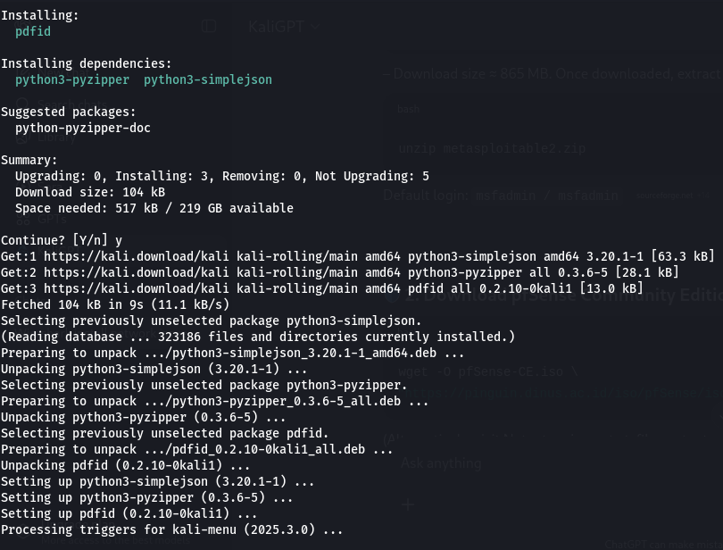
Key Terminal Commands & What They Do.
INSTALLING THE PDFID TOOL

Slide 8
Hands-on lab analyzing a PDF file for potential threats
Navigate to the Directory.
List the File.
Run Basic pdfid Run the basic scan on your file
What to look for in the output:
/JavaScript – indicates embedded scripts (usually bad)
/OpenAction – executes actions on open
/Launch – can launch commands (very suspicious)
/EmbeddedFile or /RichMedia – may hide malware

Slide 9
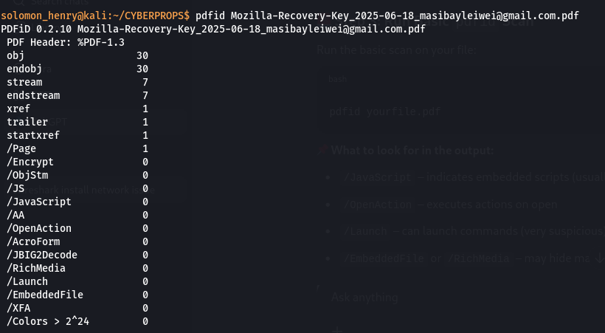
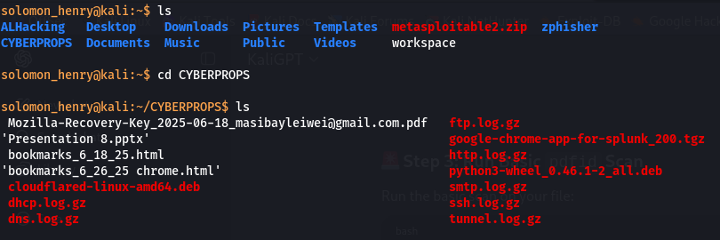
If you see any non-zero values for /JavaScript, /OpenAction, or /Launch, the PDF is highly suspicious.

Slide 10
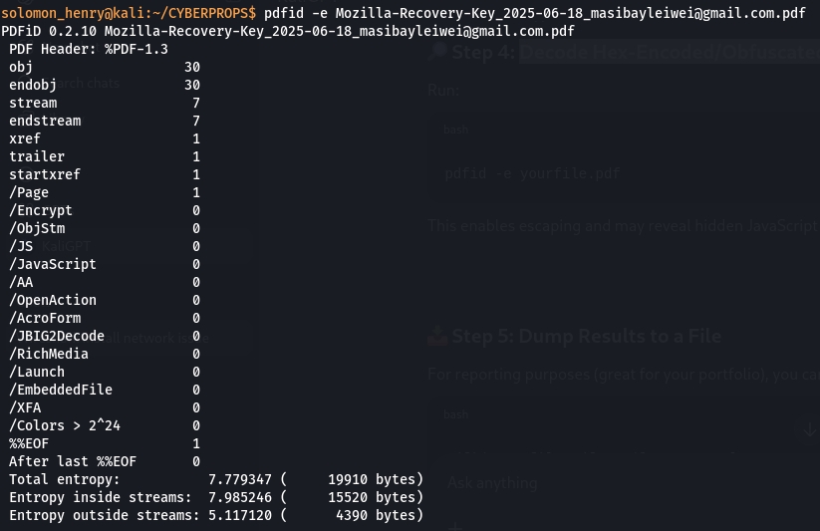
Decode Hex-Encoded/Obfuscated Content
This enables escaping and may reveal hidden JavaScript that wasn't detected in plain format.

Slide 11
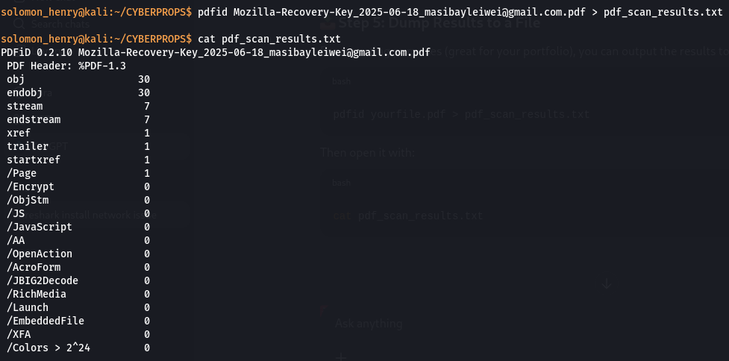
Dump Results to a File
For reporting purpose I output the results to a .txt file:

Slide 12
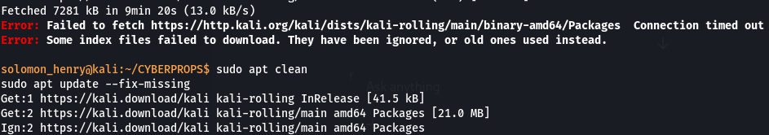
I got some errors due to bad network from the weather and I was able to fix the broken dependencies, and installed the exiftool.

Slide 13
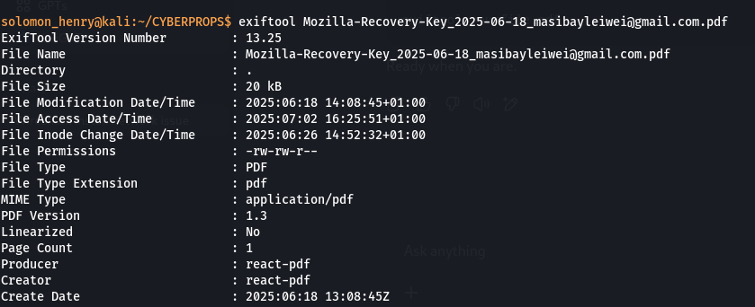
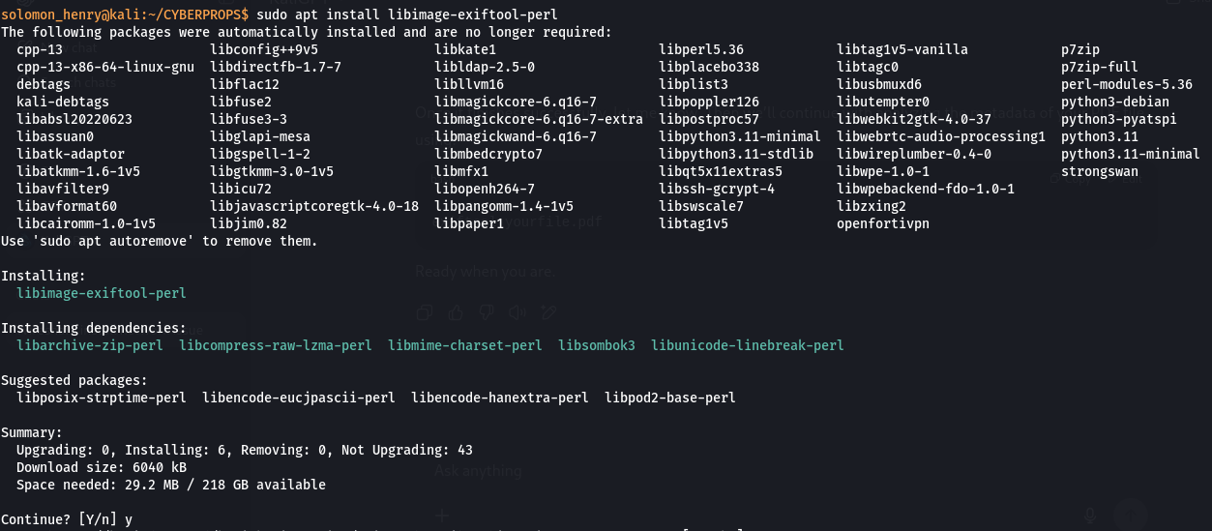
Problem solves so I went ahead and continue. Combine With Metadata Scan
For deeper inspection, and follow up.
This reveals:
Author - PDF generator
Creation timestamp (can be spoofed) - Modification history
Expands the scan to detect encoded/embedded JS that might not appear in plain form.
Extracts and decodes hidden payloads or obfuscated code within PDF streams.
Batch analysis for HR teams or shared folders—helps identify risky documents at scale.

Slide 14
SOC Use Case Simulation
🔎 Scenario: Resume.doc disguised as Resume.pdf hits HR inbox
Steps:
HR saves the PDF to shared drive
SOC script auto-runs pdfid across all PDFs in /inbound
pdfid detects /Launch and /JavaScript
Alert is triggered → File quarantined → HR notified
Analyst extracts metadata, hashes file, checks VirusTotal

Slide 15
Real-World Impact & Business Value
- Prevents zero-click exploits (OpenAction, AA execution)
- Saves HR from resume-based phishing attempts
- Reduces risk of waterhole-style PDF drive-by attacks
- Bolsters Blue Team's ability to pre-scan documents before SOC triage
- Low resource overhead—can be part of CI/CD, mail pipelines, or SOC hunting tools

Slide 16
Automate pdfid scan + hash with Bash/Python scripts
Chain with:
exiftool – deeper metadata
-pdf-parser.py – for deep inspection
yara rules – for PDF behavior-based detection
📈 Include detection metrics in SOC dashboards (Splunk, Graylog, or ELK)
🧩 Package in my Red/Blue Team toolkit for social engineering simulations

Slide 17
🧪 Case Study: Detecting Hidden Metadata in PDF Using ExifTool – Threat Simulation
Scenario:
As part of my Cyber Threat Detection & Response lab, I analyzed a suspicious recovery key PDF file using ExifTool on my hardened Kali Linux box.
The objective:
detect potential indicators of compromise and metadata revealing suspicious generation methods.

Slide 18
VISUAL AID
🔍 File Details:
Filename: Mozilla-******************************leiwei@gmail.com.pdf
Size: 20 kB
PDF Producer & Creator: react-pdf
Creation Date: 2025:06:18 13:08:45Z
Linearized: No (this can indicate the file wasn’t optimized for web viewing — suspicious for some phishing lures)
Permissions: rw-rw-r-- (exposed to group read/write)

Slide 19
Lessons for Enterprise Teams:
ExifTool is invaluable for detecting phishing attempts hiding in PDF attachments.
HR and finance departments often receive PDF attachments—this analysis could prevent waterhole and spear-phishing attacks.
Outcome:
The metadata confirms the document was programmatically created using React-PDF, often used for automation or fake form generation.
There are no embedded JavaScript, suspicious actions, or hidden files at this stage, but the tool allowed quick threat triage.

Slide 20
Automated PDF Threat Detection
TITLE:
Proactive Defense: Real-Time PDF Threat Monitoring Script
CONTEXT:
Implemented a live PDF scanning solution to detect phishing documents downloaded by end-users.
Combines pdfid + inotifywait + systemd for bulletproof automation.

Slide 21
Alerting System Using pdfid
I build a bash-based detection script that auto-scans every newly downloaded PDF on my system using pdfid and flags any that contain embedded JavaScript or launch actions.

Slide 22
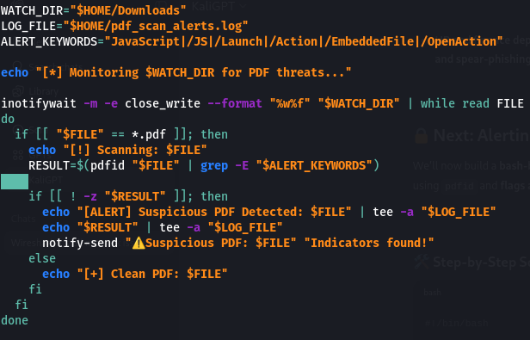
How It Works:
📁 Watches the Downloads folder using inotifywait.
🔍 Uses pdfid to scan for:
/JavaScript
/Launch
/OpenAction
/EmbeddedFile
📢 Sends a desktop alert and logs suspicious findings to pdf_scan_alerts.log.
This gives it permission to run as a standalone program.

Slide 23

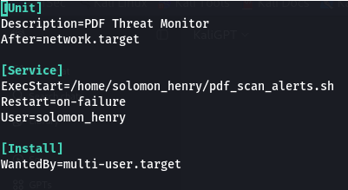
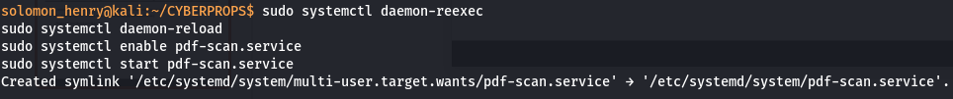
Integrated the PDF monitoring alert script with system startup using systemd
🧰 Deploying PDF Threat Monitor at Startup (Systemd Service)
Creating the Systemd Service File.
Enable and Start the Service
This will now automatically
monitor new PDF downloads
every time my Kali system boots.

Slide 24
📊 Summary:
🧠 What Learned | 💡 Application in Real Environments
Metadata reveals hidden behavior | Monitor file origins & suspicious flags
PDFiD flags embedded scripts & launch actions | Helps triage attachments in SOC
inotifywait enables real-time alerting | Great for Red Team/Blue Team labs
Alerting with notify-send and logging | Supports DFIR, audit & accountability
ExifTool helps verify PDF origin, version | Adds forensic depth to PDF analysis

Slide 25
Final Takeaways + Branding
Not all payloads come as EXEs—sometimes, the real threat is a report, contract, proposal, resume or invoice.pdf.
🔐 Key Takeaways:
Combining lightweight CLI tools = a powerful pre-screening defense layer.
This lab reinforces the mindset of security at first touch—validating even before double-click.
Integrates well with SOC playbooks, phishing defenses, and even Red Team payload evaluation.
🎯 Use Case Tie-ins:
SOC Analyst: Triage suspicious files at the entry point.
Red Team: Validate crafted PDFs for stealth testing.
Blue Team: Enforce document hygiene across departments.

Slide 26
THANK YOU

